Slide 1
Data in statistical learning
Different plots for analysis
Univariant
Bi Variant
Multi Variant
Plots in seaborn and matplotlib
Feature Engineering and importance of visualization

Slide 2
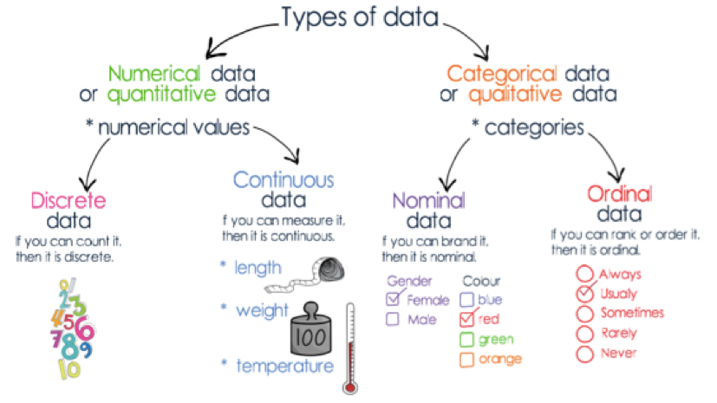
Data

Slide 3
How to pick the right plot ?
There are four basic presentation types that you can use to present your data:
Comparison
Composition
Distribution
Relationship
To determine which chart is best suited for each of those presentation types, first you must answer a few questions:
Number of Variables : One, two, three, many?
Number of datapoints: Only a few or many?
Type of value display: over a period of time, or among items or groups?
Source: https://eazybi.com/blog/data_visualization_and_chart_types/

